Slide 1

Data Science Capstone Project Report
Holly Tibble

Slide 2

Edinburgh loves its coffee
Over the limited warm summer months in the Scottish city of Edinburgh, it is popular for locals to spend much of their day in the public parks – socialising, drinks and barbequing. Having recently procured a license for a mobile coffee shop, I am trying to identify the best spots in the city as a vendor.

Slide 3

The perfect spot
As I will be operating out of a vehicle, I will not be able to provide customer toilets. As such, I would like to find spots with nearby public (or publicly accessible) toilets (maximum range 500 metres).
My license allows me to park my cart on the edge of public parks, but I prefer to be nearby to park play areas as I think my target audience is probably parents and families, rather than young adults who are perhaps more likely to be consuming alcohol.

Slide 4

Data
The data I will be using to find suggested locations for my coffee cart will be the locations of public play areas, public toilets, and other local shops, from Foursquare.

Slide 5
First, I conducted a many-to-many merge on the play areas (henceforth ‘sites’) and public toilets, such that all possible pairs were generated. In this merged data I calculated the distance between the site and the toilet, using geodesic distance implemented using the geopy package.
Geodesic distance, or great-circle distance, is defined as the distance between any two points on a sphere. While the earth is not quite perfectly spherical, geodesics on an ellipsoid are more computationally intensive, and rarely improve accuracy by more than 0.5% . On such a small scale as we are using, the difference is negligible.
Toilets over 500 metres from the site were excluded, and the unique sites with public toilets within range were identified and retained.
Methodology

Slide 6
Venues of any type within a 1km range of each retained site were identified from the foursquare database. Coffee shops and cafés were separated, and the number within radius of each site was counted. Next, other venues were assessed by converting the category description into a binary variables, using one-hot encoding. For each site, the mean of each binary category variable was calculated for the neighbouring venues, to estimate the relative frequency of the venue type in the vicinity.

Slide 7
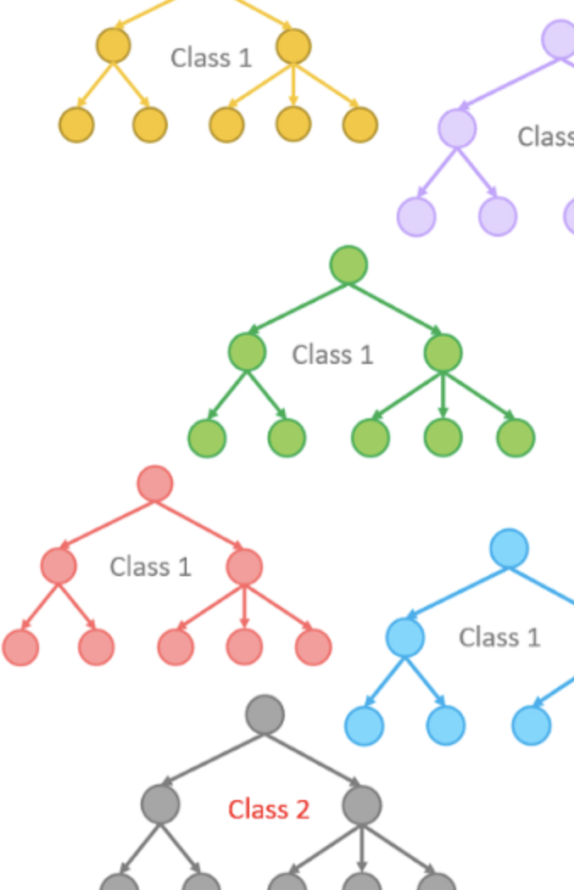
My aim was to identify areas in which a coffee shop would be likely to be successful, but in which there were fewer than expected currently operating establishments. To identify these areas, I created a random forest regression model (from sklearn) to estimate the number of coffee shops within range of each site, using their other neighbouring venues as predictor variables. I then ran the data back through the model to create the model’s predictions of the number of coffee shops, and identified areas with fewer coffee shops than expected, defined as having a regression output of at least 0.5 coffee shops higher than the observed value.

Slide 8
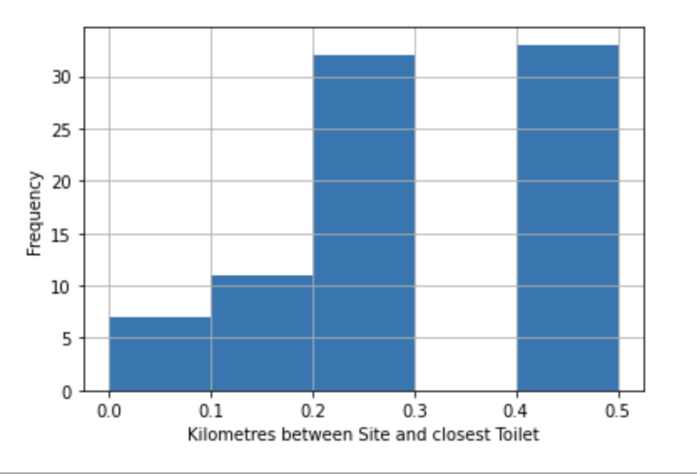
Results
154 public play areas and 97 public or publicly accessible toilets were identified with coordinates in the Edinburgh open datasets.
83 unique sites had toilets within 500m, with a mean distance to the closest public toilet of 290 metres.

Slide 9
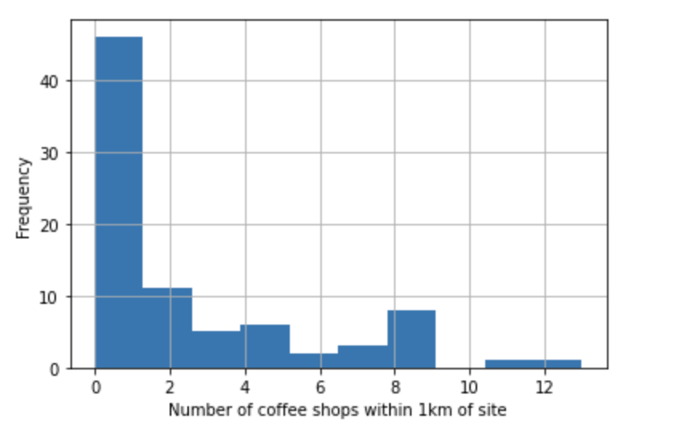
47
of the sites had a coffee shop within 1km
(57%)

Slide 10
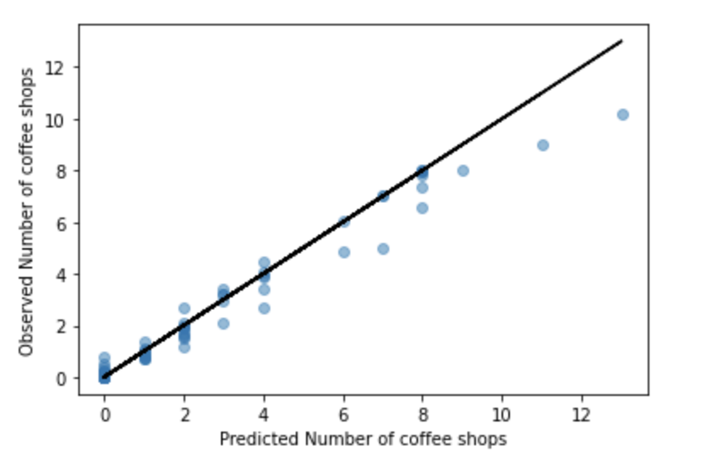
There were three points with a predicted number of nearby coffee shops of at least 0.5 higher than the observed number.
Clermiston Park
East Pilton Park
Granton Crescent

Slide 11
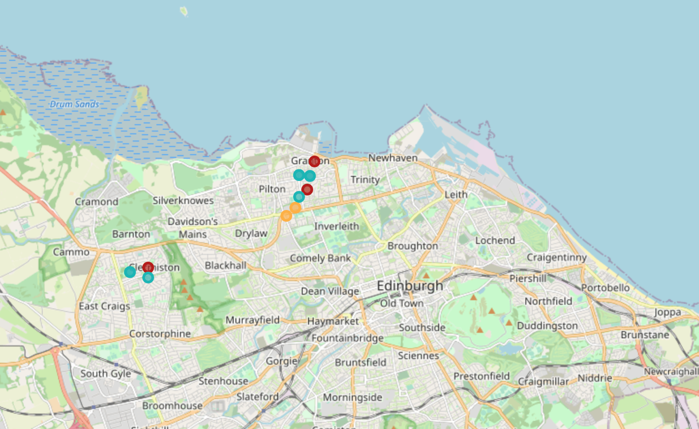
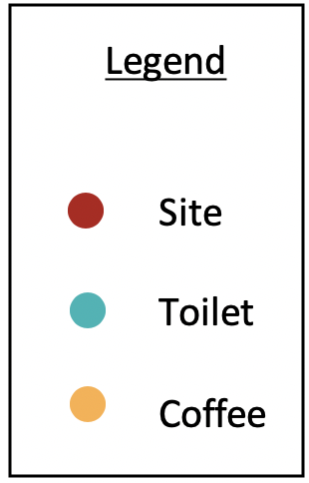
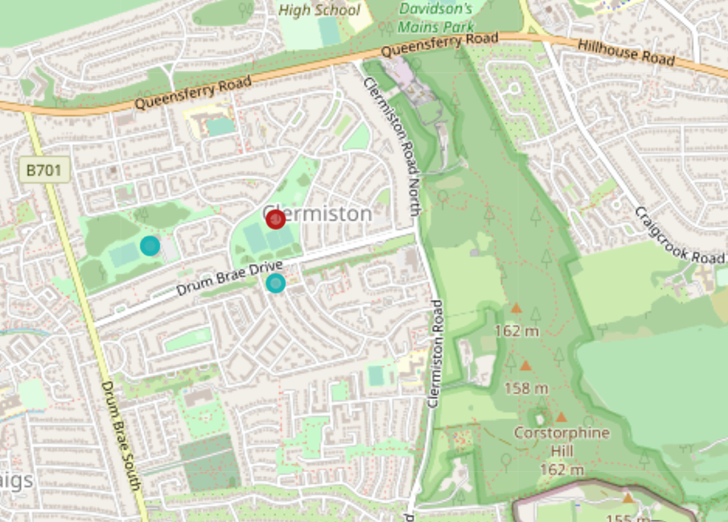
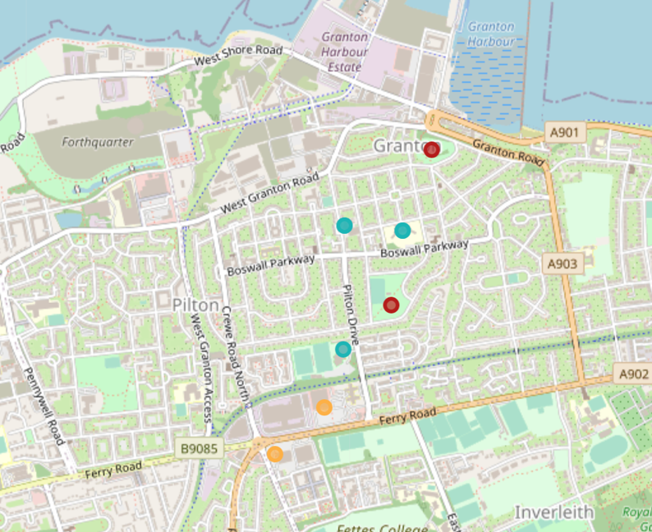

Slide 12
Thank you!

